Slide 1


European
Digital Skills
Awards 2026
Meet the finalists!

Slide 2




Central Hub for all stakeholders interested in Digital Skills
High quality content: European and national initiatives, good practices, pledges, training and funding opportunities, learning space, events, Academies, and many more…
European Digital Skills Awards 2026

Slide 3

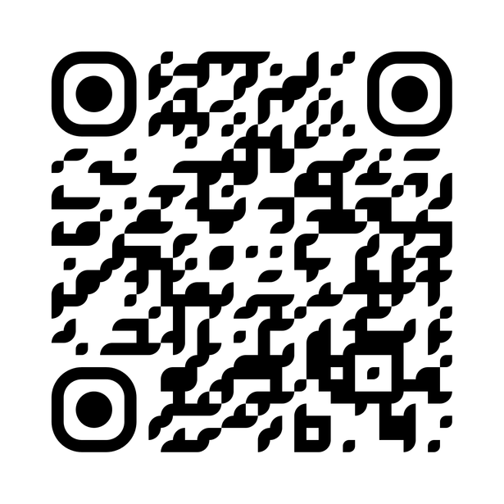
Central Hub for all stakeholders interested in Digital Skills
High quality content: European and national initiatives, good practices, pledges, training and funding opportunities, learning space, events, Academies, and many more…

Slide 4

Greetings from the European Commission
Ioannis Gaviotis
Policy Officer
European Commission
European Digital Skills Awards 2026

Slide 5
Objectives
Showcase the best projects, stories,
and initiatives from across Europe
Highlight and reward achievements and
innovation in Digital Skills​ from Europe
Collect new good practices and projects to present in the Digital Skills and Jobs Platform
European Digital Skills Awards 2026

Slide 6
2016 & 2017 & 2018
Some of the projects are still running and continue to produce an impact, empowering Europeans of all ages and walks of life to acquire digital skills.
Previous
editions
2023 & 2024 & 2025
The Digital Skills and Jobs Platform is running the awards, always in collaboration with the European Commission and the National Coalitions for Skills and Jobs all around Europe.
European Digital Skills Awards 2026

Slide 7
European
Digital Skills
Awards 2026

Slide 8


Digital Upskilling @Work
Digital Skills for Education
Inclusion in the Digital World
220
applications
32
90
64
Women in
ICT Careers
Cybersecurity
Skills
21
13
European Digital Skills Awards 2026

Slide 9



Top 3 applicant
countries
39 applicants
31 applicants
27 applicants
from Spain
from Greece
from Italy
European Digital Skills Awards 2026

Slide 10

Get to know
the Jury
of EDSA26!
European Digital Skills Awards 2026

Slide 11
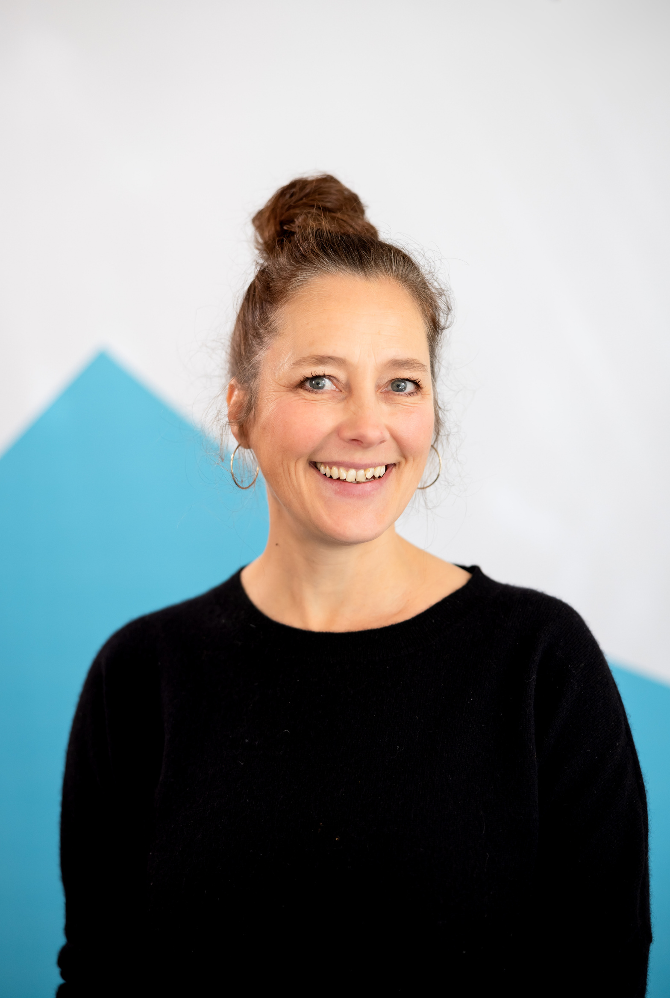
Katharina Kunze
Project Manager Deutschland sicher im Netz e.V. (DsiN)
#EDSA25 Winner
European Digital Skills Awards 2026

Slide 12
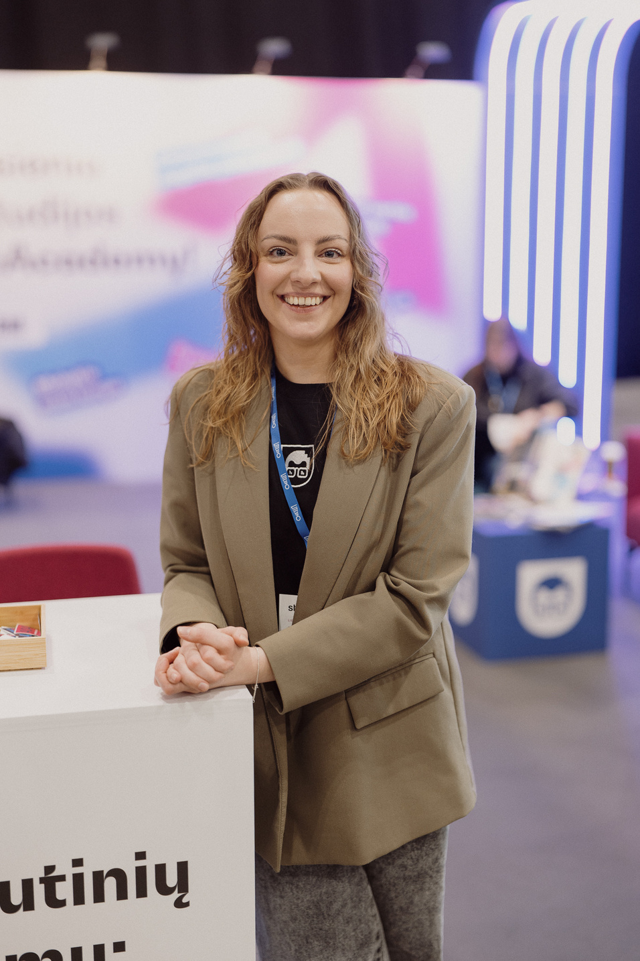
Kotryna Jankūnaitė
Head of Product at
CodeAcademy
European Digital Skills Awards 2026

Slide 13
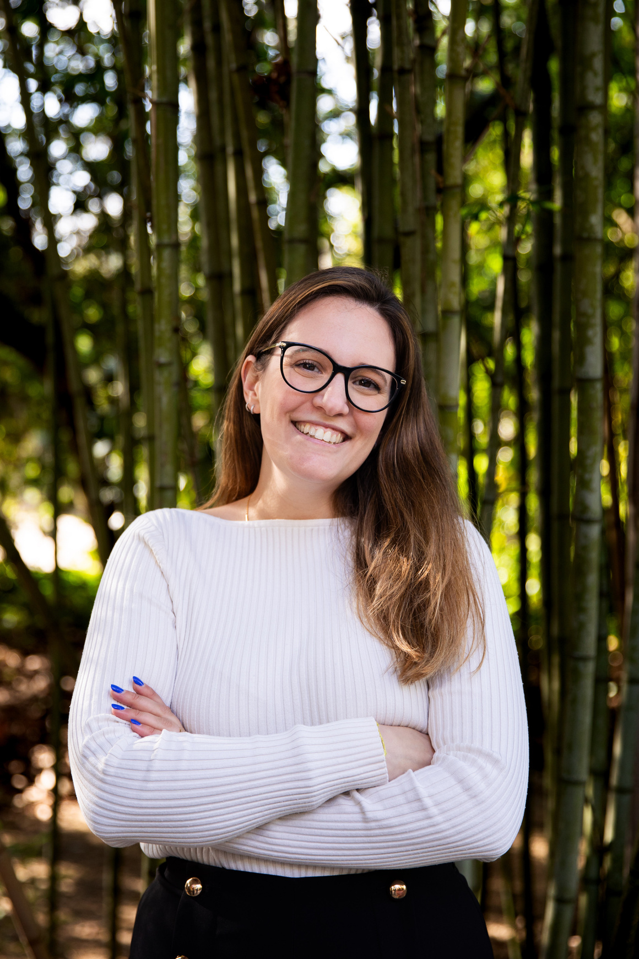
Mónica Canário
Project Coordinator at the Portuguese Association for Diversity and Inclusion (APPDI)
#EDSA25 winner
European Digital Skills Awards 2026

Slide 14
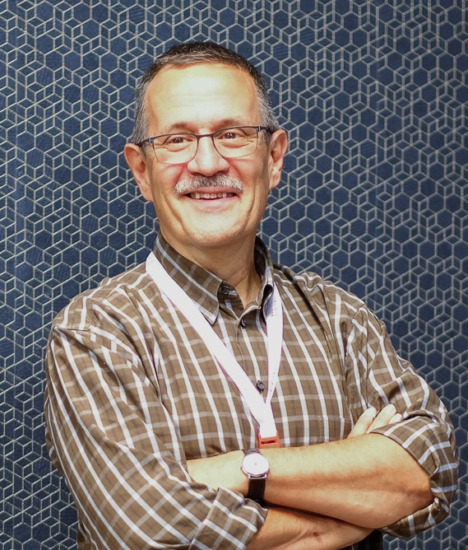
Stefano Kluzer
Senior expert at All Digital, Moderator of the DigComp community of practice (CoP)
European Digital Skills Awards 2026

Slide 15
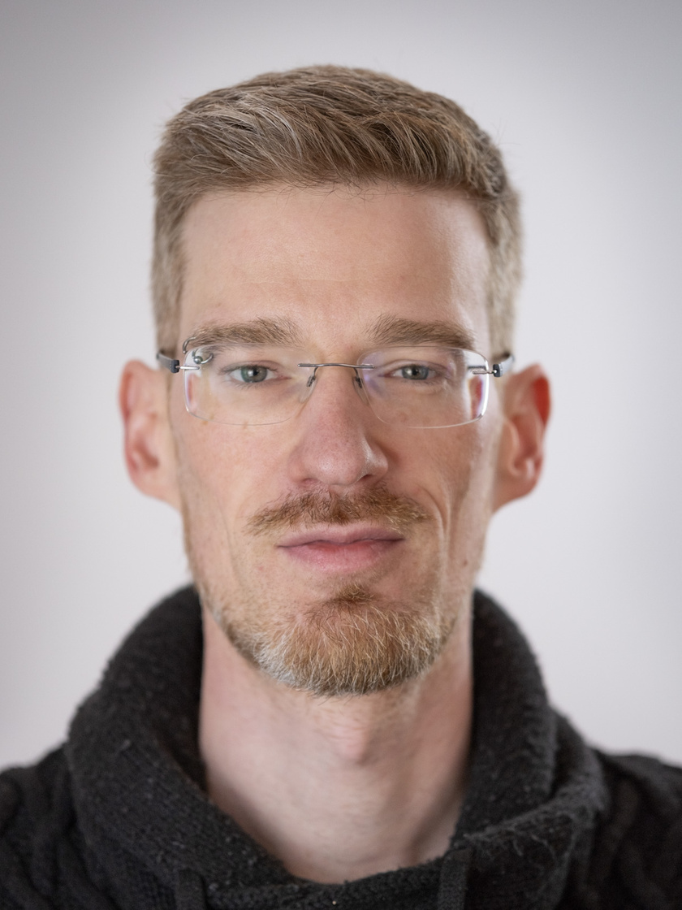
Thomas Layer-Wagner
CEO and Founder of Polycular
#EDSA25 winner
European Digital Skills Awards 2026

Slide 16
The finalists
for the 2026
edition are...

Slide 17
Digital Upskilling
@Work
Presented by Kotryna Jankūnaitė
European Digital Skills Awards 2026

Slide 18

Digital Upskilling @Work FINALIST
Training programme for civil servants on digital skills
Agenția Națională a Funcționarilor Publici
Romania
European Digital Skills Awards 2026

Slide 19

Digital Upskilling @Work FINALIST
Consortium FAIRmat
Humboldt-Universität zu Berlin
Germany (primary), with collaborations across Europe and beyond
European Digital Skills Awards 2026

Slide 20

Digital Upskilling @Work FINALIST
Portugal Tech Week
351 Associação Portuguesa de Startups
Portugal
European Digital Skills Awards 2026

Slide 21

Digital Upskilling @Work FINALIST
SectorAI Upskilling
Code for All, S.A
Portugal
European Digital Skills Awards 2026

Slide 22

Digital Upskilling @Work FINALIST
Slovak Association of Digital HR
Slovakia, Czech, Austria and Dubai
European Digital Skills Awards 2026

Slide 23
Digital Upskilling @Work Finalists
Training programme
for civil servants on digital skills
Națională a Funcționarilor Publici
Consortium FAIRmat
Humboldt-Universität zu Berlin
Portugal Tech Week
351 Associação Portuguesa de Startups
SectorAI Upskilling
Code for All, S.A
Slovak Association of Digital HR
European Digital Skills Awards 2026

Slide 24
Digital Skills
for Education
Presented by Thomas Layer-Wagner
European Digital Skills Awards 2026

Slide 25

Digital Skills for Education FINALIST
BrAIn
Application of Artificial Intelligence-Based Digital Technologies in Education
CARNET - Hrvatska akademska i istraživačka mreža
Croatia
European Digital Skills Awards 2026

Slide 26

Digital Skills for Education FINALIST
An Essential Digital Competency: AI Literacy
Colegio San Buenaventura
Spain, Türkiye, Italy and Germany
European Digital Skills Awards 2026

Slide 27

Digital Skills for Education FINALIST
Generation AI
University of Eastern Finland
Finland
European Digital Skills Awards 2026

Slide 28

Digital Skills for Education FINALIST
Girls Go STEM
EIT RawMaterials
38 countries
European Digital Skills Awards 2026

Slide 29

Digital Skills for Education FINALIST
Golinelli LiVE –
Live Virtual Experience
G-lab S.r.l. Impresa sociale
Italy
European Digital Skills Awards 2026

Slide 30
Digital Skills for
Education Finalists
BrAIn
CARNET - Hrvatska akademska i istraživačka mreža
An Essential Digital Competency:
AI Literacy
Colegio San Buenaventura
Generation AI
University of Eastern Finland
Girls Go STEM
EIT RawMaterials
Golinelli LiVE – Live Virtual Experience
G-lab S.r.l. Impresa sociale
European Digital Skills Awards 2026

Slide 31
Inclusion in the Digital World
Presented by Stefano Kluzer
European Digital Skills Awards 2026

Slide 32

Inclusion in the Digital World FINALIST
#DiscussAI
ADAPT Research Centre
Ireland
European Digital Skills Awards 2026

Slide 33

Inclusion in the Digital World FINALIST
AppLI
Italy’s Personal Assistant for Employment Golinelli
Ministero del Lavoro e delle Politiche Sociali
Italy
European Digital Skills Awards 2026

Slide 34

Inclusion in the Digital World FINALIST
My Digital Bank:
Easy and Safe
Asociación Somos Digital
Spain
European Digital Skills Awards 2026

Slide 35

Inclusion in the Digital World FINALIST
Scratch Tactile
tangible and inclusive programming for a barrier-free digital education
Sistema THEAD sccl
Spain (with international uptake by educators in 70+ countries)
European Digital Skills Awards 2026

Slide 36

Inclusion in the Digital World FINALIST
STATUS QUEST
Fondazione M-Cube
Italy, Germany
European Digital Skills Awards 2026

Slide 37
Inclusion in the Digital World Finalists
#DiscussAI
ADAPT Research Centre
AppLI: Italy’s Personal Assistant for Employment
Ministero del Lavoro e delle Politiche Sociali
My Digital Bank:
Easy and Safe
Asociación Somos Digital
Scratch Tactile
Sistema THEAD sccl
STATUS QUEST
Fondazione M-Cube
European Digital Skills Awards 2026

Slide 38
Women
in ICT Careers
Presented by Mónica Canário
European Digital Skills Awards 2026

Slide 39

Women in ICT Careers FINALIST
THRIVE
Upskilling for Women
Kiron Open Higher Education gGmbH
Germany, Switzerland, Austria
European Digital Skills Awards 2026

Slide 40

Women in ICT Careers FINALIST
Girls in STEAM Academy
Be an Ally Foundation
Cyprus
European Digital Skills Awards 2026

Slide 41

Women in ICT Careers FINALIST
Program for the elimination of the digital gender gap
#GirlsSTEAM
Federación Mujeres Jóvenes
Spain
European Digital Skills Awards 2026

Slide 42

Women in ICT Careers FINALIST
STEM4Girls UC3M
Universidad Carlos III de Madrid
Spain
European Digital Skills Awards 2026

Slide 43

Women in ICT Careers FINALIST
Technovation
Girls Portugal
Associação EDruptiva
Portugal
European Digital Skills Awards 2026

Slide 44

Women in ICT Careers Finalists
THRIVE
Upskilling for Women
Kiron Open Higher Education gGmbH
Girls in STEAM Academy
Be an Ally Foundation
Program for the elimination of the digital gender gap
#GirlsSTEAM
Federación Mujeres Jóvenes
STEM4Girls UC3M
Universidad Carlos III de Madrid
Technovation Girls Portugal
Associação EDruptiva
European Digital Skills Awards 2026

Slide 45
Cybersecurity
Skills
Presented by Katharina Kunze
European Digital Skills Awards 2026

Slide 46


Cybersecurity Skills FINALIST
Command ALERT
CWU Campus
Spain, Dominican Republic, Costa Rica, Honduras and Peru
European Digital Skills Awards 2026

Slide 47

Cybersecurity Skills FINALIST
Cyber Citizen
Aalto-yliopisto
Europe
European Digital Skills Awards 2026

Slide 48

Cybersecurity Skills FINALIST
HackShield Future
Cyber Heroes
HackShield
Netherlands, Sweden, Brazil, Curacao, Belgium, Cyprus, Germany, France
European Digital Skills Awards 2026

Slide 49

Cybersecurity Skills FINALIST
KiberACS -
Academy of Cybersecurity
Rīgas Tehniskā universitāte
Latvia
European Digital Skills Awards 2026

Slide 50

Cybersecurity Skills FINALIST
NERO
AdvaNced cybErsecurity awaReness ecOsystem for SMEs
TRUSTILIO BV
Netherlands, Cyprus, Sweden, Greece, France, Italy, Portugal, Belgium, Germany
European Digital Skills Awards 2026

Slide 51
Cybersecurity Skills Finalists
Command ALERT
CWU Campus
Cyber Citizen
Aalto-yliopisto
HackShield Future
Cyber Heroes
HackShield
KiberACS - Academy of Cybersecurity
Rīgas Tehniskā universitāte
NERO
TRUSTILIO BV
European Digital Skills Awards 2026

Slide 52
Want
to discover
the winners?
You'll have to wait until
30 June 2026!

Slide 53
Thank you!

